Slide 1
Measuring the Impact of Open Source Software Innovation Using Network Analysis on
GitHub Hosted Python Packages
Team Members: Derek Banks, Camille Leonard, Shilpa Narayan, Nick Thompson
Client and Sponsor: Gizem Korkmaz, Brandon Kramer
Faculty Advisor: Abbas Kazemipour

Slide 2
Background and Problem Statement
NSF Focus - no established method to quantify the impact of open source ecosystems
Develop a framework to measure the impact of Open Source Software (OSS) development which can be applied to any open source ecosystem eg: citations
Goal is to identify influential actors (e.g. packages, developers, countries) by using the following impact measures:
Centrality - network measures
Downloads - OSS measure
Development cost leveraged through dependencies
Notes:
Despite its extensive use, reliable measures of the scope and impact of OSS are scarce. The creation and use of OSS highlight an aspect of technology diffusion and flow that is not captured in science and technology indicators. The NSF is focusing on reasearch that can quantify the impact of OSS.
Our goal with this project was to create methods to measure the impact of of OSS using network modeling and related measurements. These included centrality, number of package downloads and calculating development costs leveraged through package dependencies.

Slide 3
Data
Package and download information sourced from PyPI through Google Big Query
Data limited to Python packages hosted on GitHub with an OSS license
72% of the PyPI data
Package information was joined with commits data scraped from GitHub
68,992 unique packages were analyzed
Reduced from 75,000 when joined with GitHub commits data
Notes:
We used data from the Python package manager obtained from Google big query. We limited the packages analyzed to those with published OSS licenses. This was 72% of the packages hosted on Pypi.
This data was merged with existing Github package data previously collected by the project sponsor. We ended up with 68992 unique packages. This data was then used to create an edge list where we created network of package dependencies.

Slide 4
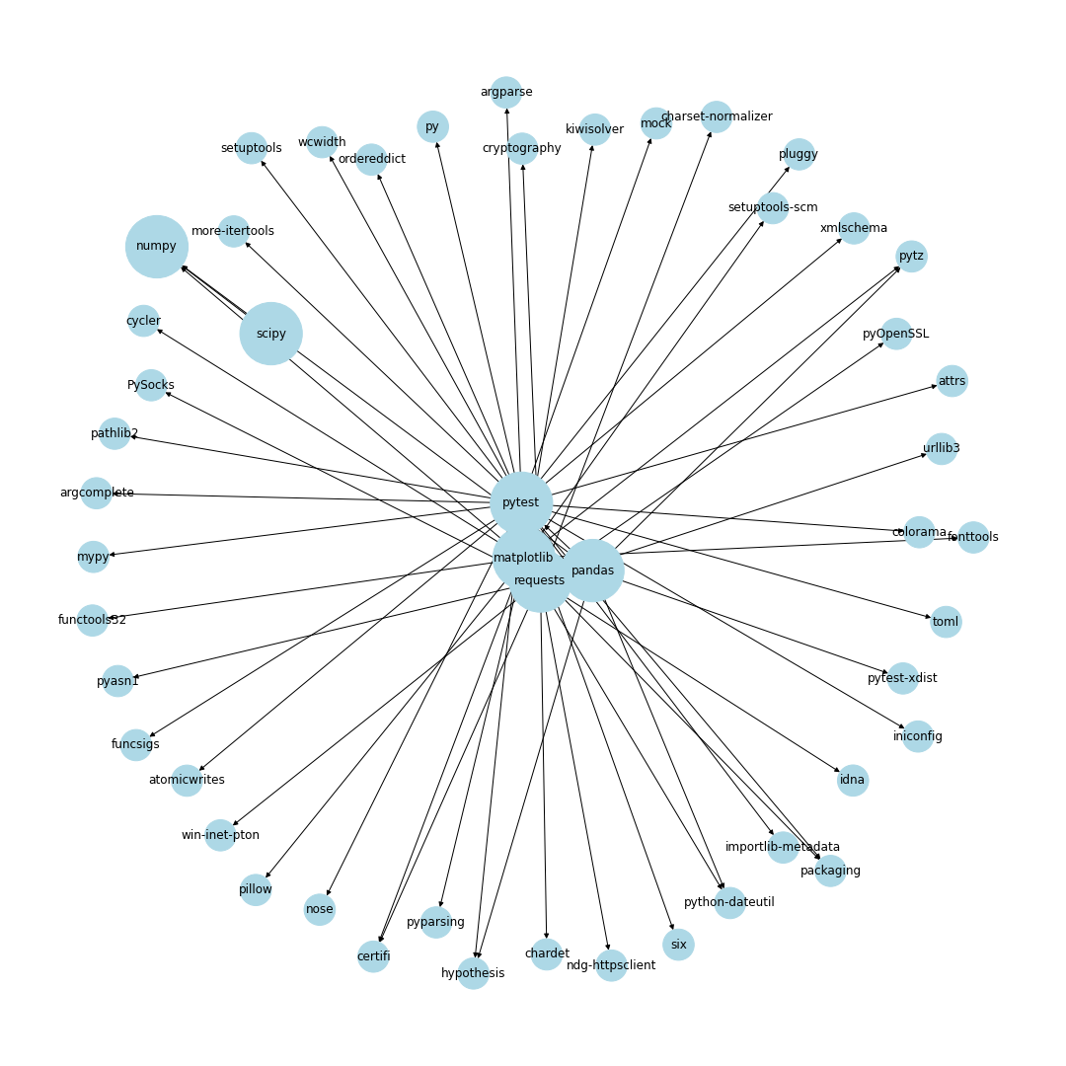
Created Dependency Network Model
Notes:
Directed acyclic graph
Package (node) that is depended upon has arrows going into it
Package (node) that is dependent upon another has arrows going out of it

Slide 5
Methods
Calculated in-degree, out-degree, and eigenvector centrality measures
Calculated package cost using breadth first search and the COCOMO II model
Effort = 2.4(KLOC)^{1.05}
Nominal development time = 2.5(Effort)^{0.38}
Development cost = (Monthly Resource Cost) (Nominal development time)
Aggregated downloads per package for use as an impact measure
Notes:
We used multiple methods to calculate the impact of packages and their dependecies.
To calculate the most influential nodes in the network we used in-degree, out-degree, and eigenvector centrality measures.
In-degree - The fraction of nodes a package’s incoming edges are connected to
Out-degree - The fraction of nodes a package’s outgoing edges are connected to
Eigen vector centrality - The measure of a node’s influence in a network based on neighbor’s connectivity as well. Therefore, a node not just connected to another node but connected to those neighbors which are highly connected matters and is more influential.
We also calculated package cost and dependency cost using the cocomo 2 model. This is an existing method for calculating software development costs.
We used breadth first search create a dependecy tree of packages and applied the cocomo 2 model to determine the dependcey cost of a given package.
Additionally we aggregated the number of downloads per package as an impact measure.

Slide 6
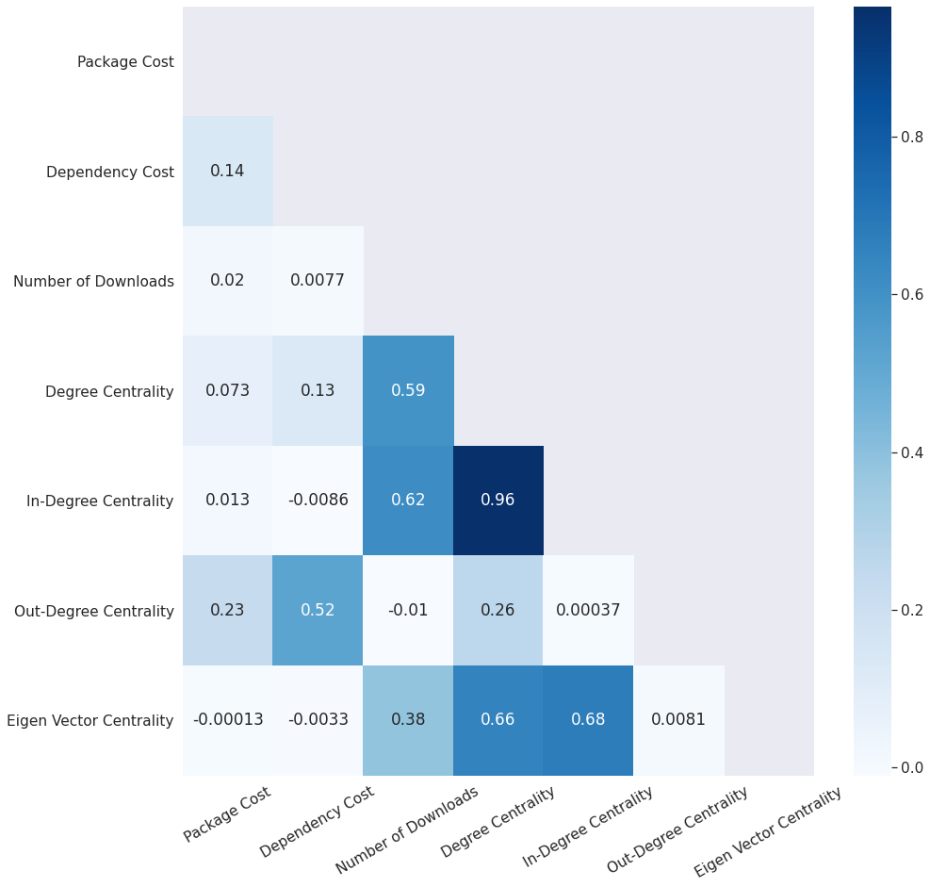
Metric Correlations
Notes:
Package dependency cost is not correlated with any centrality measures
This implies that a package with a higher value is not necessarily a impactful package.
Number of downloads is highly correlated with in degree and eigenvector centrality

Slide 7
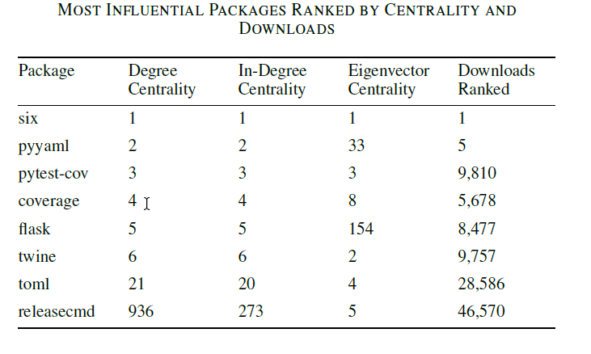
Influential Packages
Notes:
Centrality measures and number of downloads were compared for the top ranked packages.
Multiple packages ranked highly across metrics indicating that the packages were influential in multiple ways
The package “six” is the most highly ranked across all centrality measures and number of downloads
Package “six” is the most highly-connected node in the graph (degree centrality), most depended upon (in-degree centrality), is highly-connected with highly-connected neighbors (eigenvector centrality), and most-downloaded package for the time period of study.

Slide 8
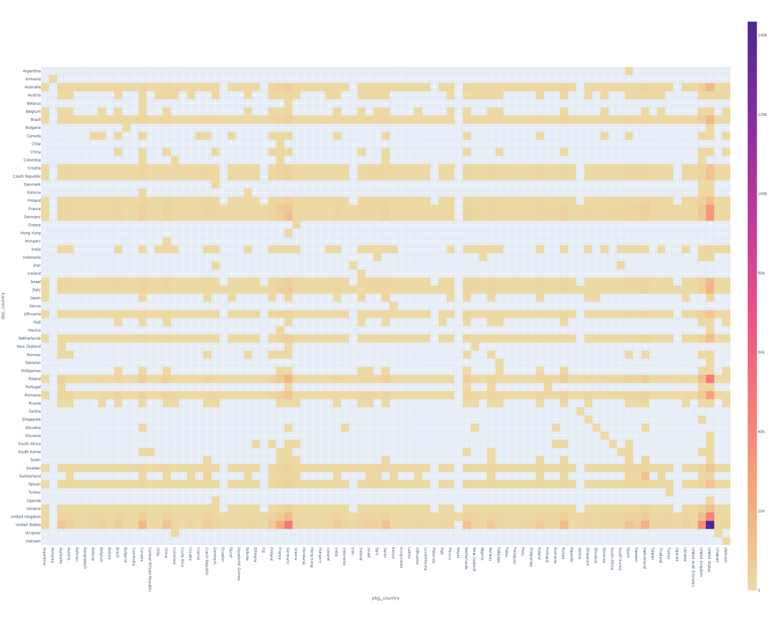
Future Work - Technology diffusion
cost
Country where the dependency package is developed
Country where the package is developed
Notes:
Technology diffusion and flow that is not captured in science and technology (S&T) indicators.
We want to extend this work to measure the impact of OSS innovation diffusion.

Slide 9
Thank you!
Questions
?

